Slide 1

ECEN 5863
Programmable Logic Embedded System Design

Slide 2


FPGA Audio Filter with Multi-Mode Switching using DE1 SoC FPGA Team: Harinarayan Gajapathy, Ruthvik Chanda, Satish Sankella, Shrinithi Venkatesan 14-Dec-24

Slide 3
Presentation Roadmap
Project Description
System Block Diagram
Programmable Logic Design
Filter Design using MATLAB
Implementation
Learning Outcomes.
Summary

Slide 4
Project Description
This project aims to provide an interactive platform for users to understand the effects of different audio filtering techniques in real-time using the DE1 SoC FPGA.
A user-friendly interface is introduced, allowing the user to dynamically toggle between four distinct audio filter options.
The available choices include unfiltered audio for a direct pass-through, low pass filter, high pass filter, band pass filter and All-pass filter.

Slide 5
Project Description
Implementation Stages:
Stage 1: Implementing each filter individually involves meticulously developing and testing the Unfiltered, Low-Pass, High-Pass, Band-Pass, and All-Pass filters within the existing Project 3Module2 setup.
Stage 2: During the integration phase, four switches are designated for dynamic user control.
Stage 3 (Optional): Integrating the HPS (Hard Processor System) into the FPGA enhances user control over the audio filtering system.

Slide 6
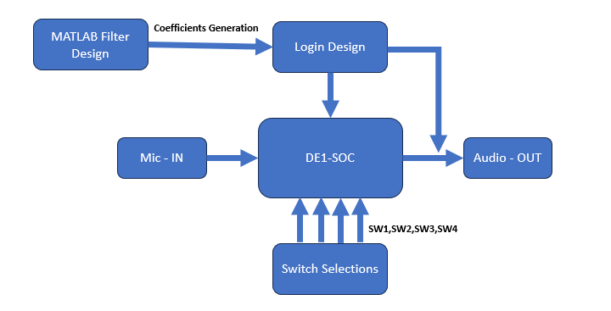
System Block Diagram

Slide 7
Programmable Logic Design
Implemented FIR lowpass, high pass, and bandpass filters in Verilog.
Derived the necessary coefficients using MATLAB, providing appropriate inputs.
Verified the functionality of the filters in MATLAB.
Validated in Quartus using the provided Audio CODEC IP implementation and captured results.

Slide 8
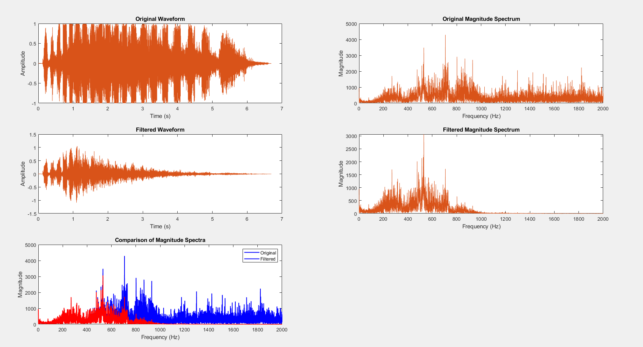
Filter Design using MATLAB
Low Pass Filter Characteristics: Cutoff Frequency: 600Hz, Filter Order: 50
Filter Functionality: Permits frequencies below 600Hz. Attenuates frequencies beyond the cutoff.

Slide 9
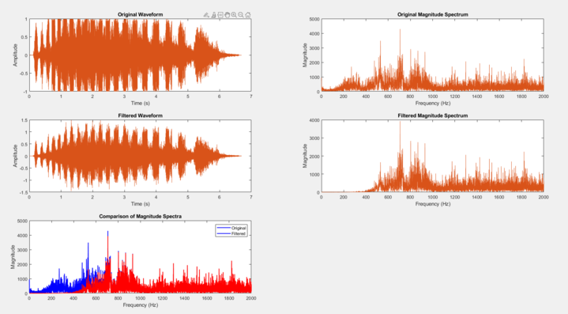
Filter Design using MATLAB
High Pass Filter Characteristics: Cutoff Frequency: 600Hz, Filter Order: 50
Filter Functionality: Permits frequencies above 600Hz. Attenuates frequencies below the cutoff.

Slide 10
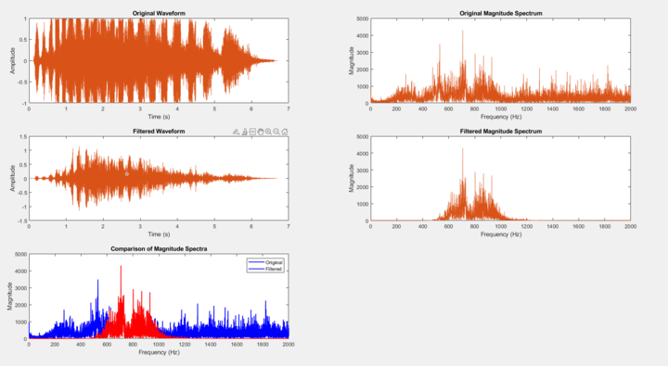
Filter Design using MATLAB
Band Pass Filter Characteristics: Cutoff Frequency1: 600Hz, Cutoff Frequency2: 1000Hz, Filter Order: 50
Filter Functionality: Permits frequencies below 600Hz. Attenuates frequencies beyond the cutoff. Sampled at 48Khz

Slide 11
Proof of Concept Realization:
Clock for filter is 50MHz, audio sample 48KHz, How to pass samples?
FIR Filter Digital implementation requires co-efficients for stop band and pass band, how?
Audio codec works on 24-bit input and output, filter output varies based on order, how to pass data?
Real value co-eficients give 64-bit output, fixed point co-efficients gives 33-bit output or more for 50 stage

Slide 12
Implementation:
Step 1: Synchronize Sampling Frequency
Step2: Filter Design
Step 3: Generate Co-efficients
Step 4:Programmable Logic implementation
Step 5: Validate

Slide 13
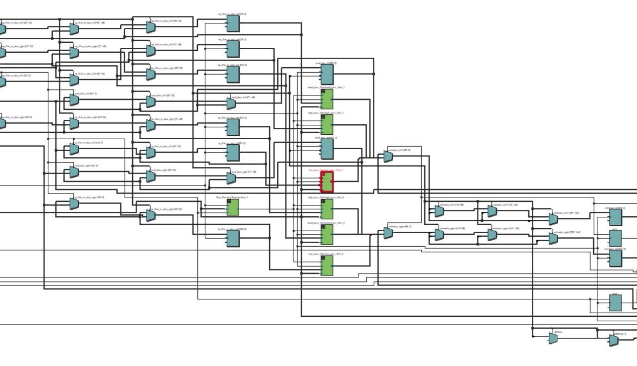
Top Level RTL Viewer
Band Pass Filter Characteristics: Cutoff Frequency1: 600Hz, Cutoff Frequency2: 1000Hz, Filter Order: 50
Filter Functionality: Permits frequencies below 600Hz. Attenuates frequencies beyond the cutoff. Sampled at 48Khz

Slide 14
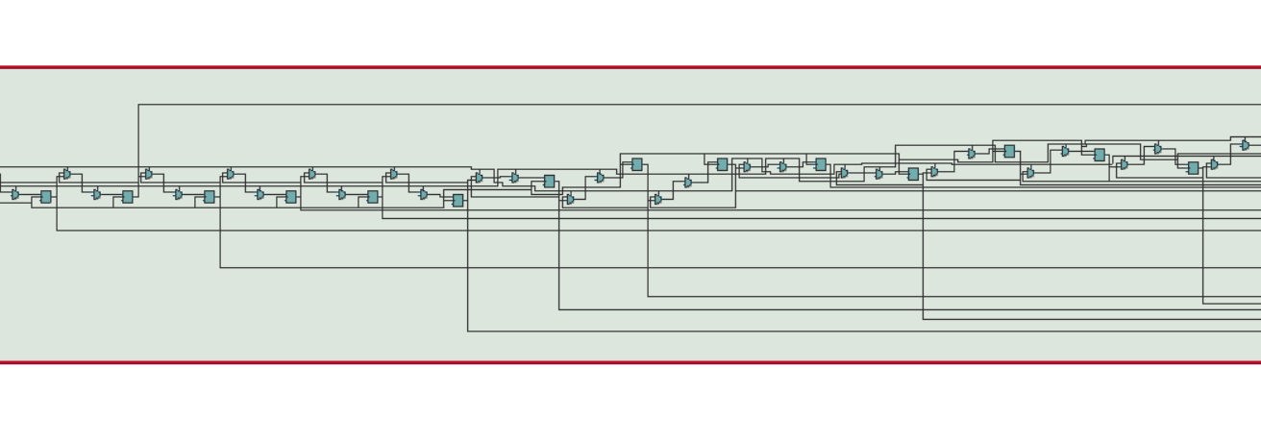
RTL Viewer of Filter
Band Pass Filter Characteristics: Cutoff Frequency1: 600Hz, Cutoff Frequency2: 1000Hz, Filter Order: 50
Filter Functionality: Permits frequencies below 600Hz. Attenuates frequencies beyond the cutoff. Sampled at 48Khz

Slide 15
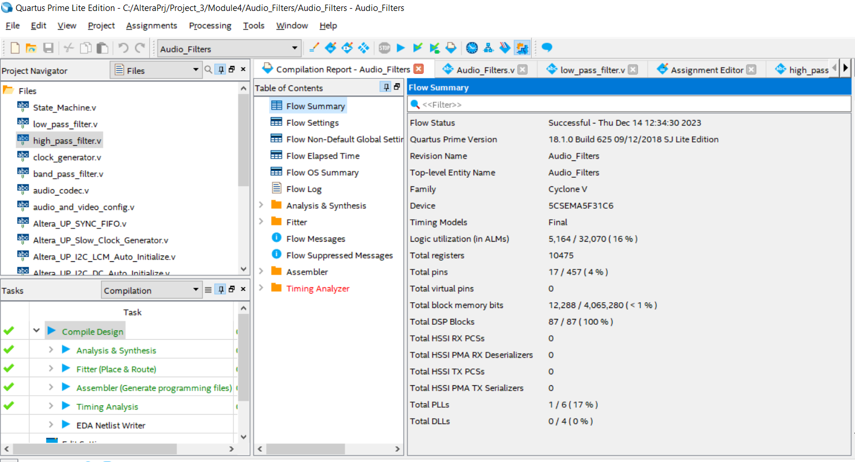
Logic Utilization
Band Pass Filter Characteristics: Cutoff Frequency1: 600Hz, Cutoff Frequency2: 1000Hz, Filter Order: 50
Filter Functionality: Permits frequencies below 600Hz. Attenuates frequencies beyond the cutoff. Sampled at 48Khz

Slide 16
Validation:
Simulated clock synchronization, filter blocks
Used a high frequency tone of 8KHz and above to verify cut-off for low-pass filter
Used a low frequency tone of 500Hz to verify high-pass
Used a frequency tone of 800Hz to verify band-pass
Used audio sweep to verify each stop and pass frequencies

Slide 17

What worked and what didn’t?
Implementation | Matlab Implementation | Hardware and software implementation
CODEC audio out | -
Basic FIR Filter
Low pass
High pass |  | Needs more testing
Bandpass |  | Needs more testing
Integration of filters with CODEC | - | Needs more testing

Slide 18
Challenges
Difficulty was encountered in translating filter coefficients generated in MATLAB to a format compatible with FPGA testing. The translation process presented unexpected issues.
The integration of the CODEC with the filter outputs did not yield the anticipated results due to discrepancies in filter performance.
Implementing real-time coefficients in Verilog proved to be challenging, leading to the adoption of fixed-point coefficients.
Managing product and accumulation bounds during the implementation of the filters presented challenges.

Slide 19
Learning Outcomes
Acquired a deep understanding of audio processing concepts and techniques, including filtering, sampling rates, and signal manipulation.
Acquired proficiency in Verilog programming to implement various audio filtering techniques in hardware.
Applied filtering techniques practically, showcasing their diverse applications and effects and understood which filter is required for our application.
Gained expertise in understanding pin planning and hardware configuration..
Applied a methodical approach to testing, starting from MATLAB and transitioning to verification in Quartus. Enhanced debugging skills and developed an expectation-driven testing approach.
Developed proficiency in performing embedded software development on a System-on-Chip (SoC) board using the C programming language.
Using Qsys for configuring hardware modules on FPGA, contributing to efficient hardware design and integration.

Slide 20
Conclusion
In summary, this project facilitated a deep understanding of audio processing principles, honed Verilog programming skills for diverse filtering techniques on the DE1 SoC FPGA, and demonstrated practical applications and effects of different filters. Proficiency in hardware integration, MATLAB algorithm design, C programming for embedded systems, and systematic testing methodologies were key takeaways. The project underscored the significance of FPGA peripherals, emphasizing pin planning and hardware configuration. Overall, it provided a well-rounded learning experience in digital signal processing and FPGA-based system design.

Slide 21
THANK YOU

